Slide 1
Advanced Image Processing
Final Project – Face Mask Detection
Presenter : Rohit Das 61047086s
2022 . 01 . 18

Slide 2
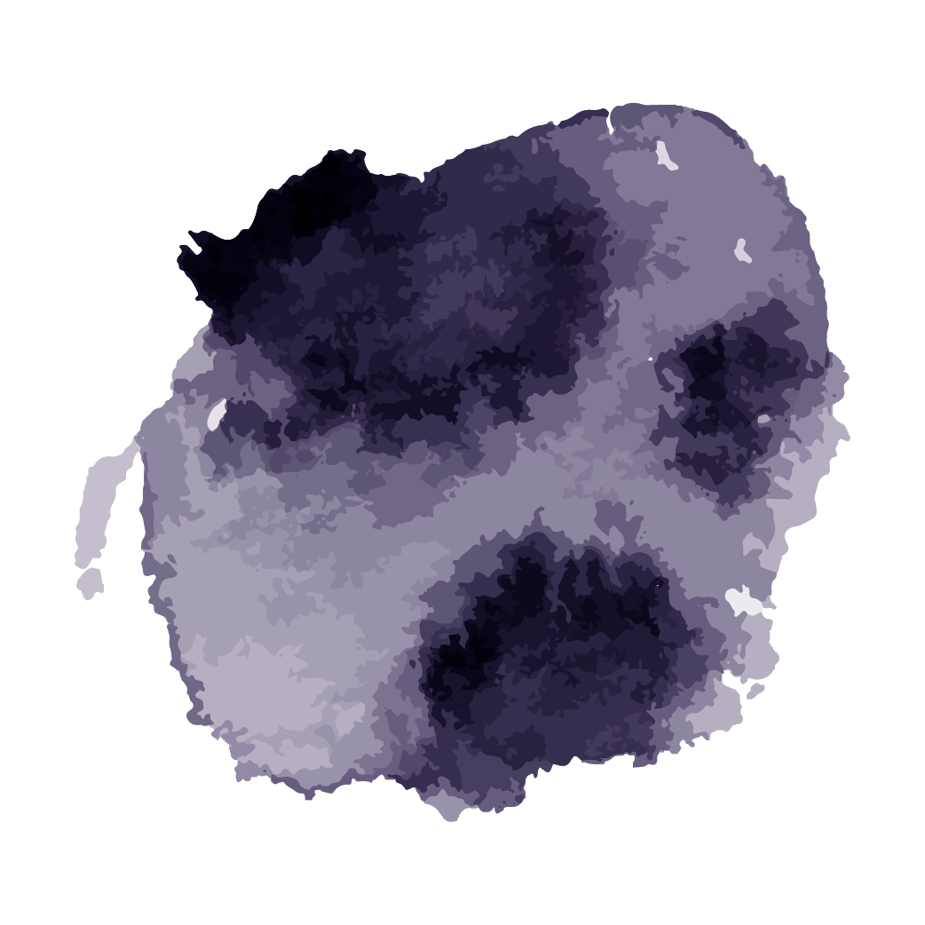
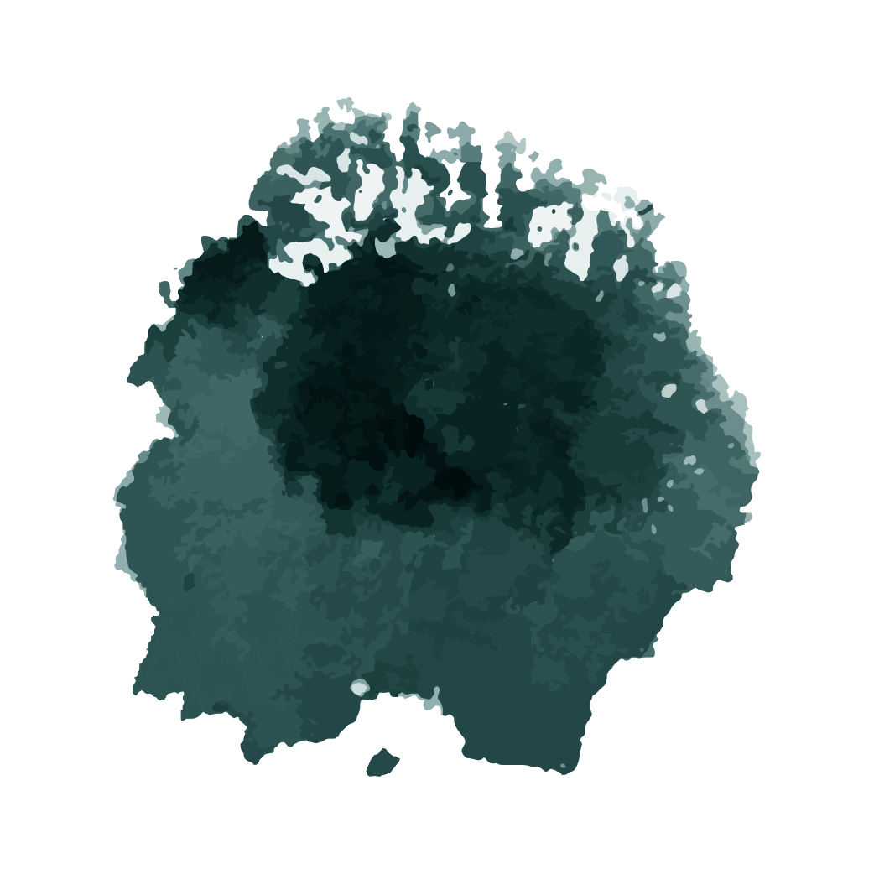
Outline
01
02
Approach
Limitations
How to do it ?
What problems I am facing still？

Slide 3
01
Approach

Slide 4
How to do it ?
01
02
03
04
05
06
Load and Preprocess Data
Data Augmentation
Training
Detection
Accuracy
Fine-Tuning

Slide 5
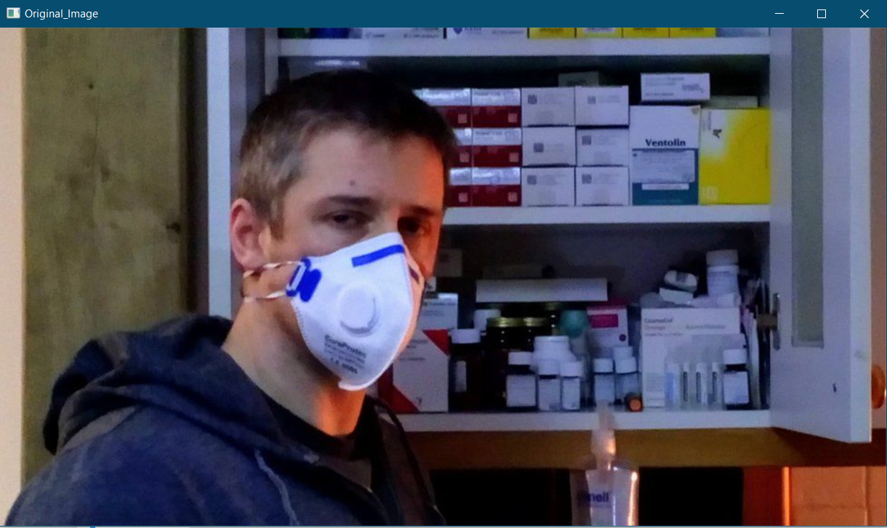
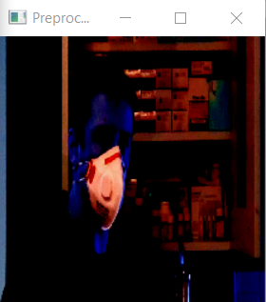
Load and Preprocess Data
Original Image
Preprocessed Image
Notes:
Grabbing all the images in the Dataset.
Initializing Data and Labels.
Converting the image to Numpy Array.
Resizing the image to 224*224.
Scaling the pixel intensities to the range[1,-1]
Appending the pre-processed image and associated label to the data and labels

Slide 6
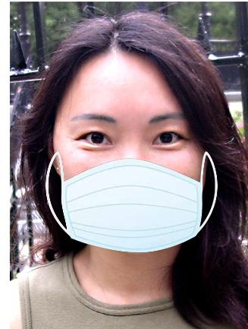
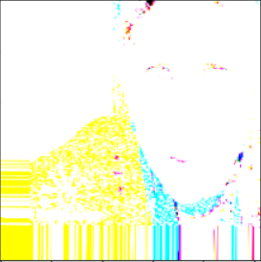
Data Augmentation
Notes:
“new” training samples from the original ones by applying random jitters and perturbations
Adds more training data
Improves Accuracy

Slide 7
Fine-Tuning CNN
Load MobileNet with pre-trained ImageNet weights leaving off head of networks
Construct a new Fully Connected head and append it to the base in the place of the old head
Freeze the base layers of the network.
The weights of the base layers will not be updated during the process of backpropagation
Notes:
MobileNetV2>AveragePooling2D>Flatten>Dense(128 activation= softmax)>Dropout(0.5)>Dense(2activation=relu)

Slide 8
Training the model
Compiling the model with Adam optimizer and binary cross entropy.
After training, serializing the face detection model to disk.
Notes:
Adam Optimizer –Adam is a replacement optimization algorithm for stochastic gradient descent for training deep learning models. Adam combines the best properties of the AdaGrad and RMSProp algorithms to provide an optimization algorithm that can handle sparse gradients on noisy problems.
Binary Cross Entropy - Binary Cross Entropy is the negative average of the log of corrected predicted probabilities

Slide 9
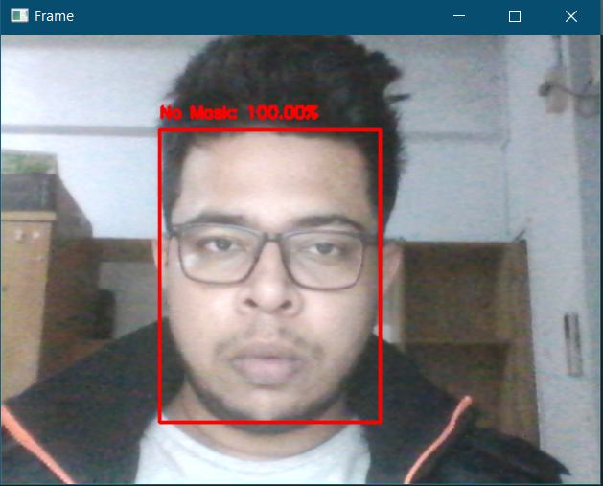
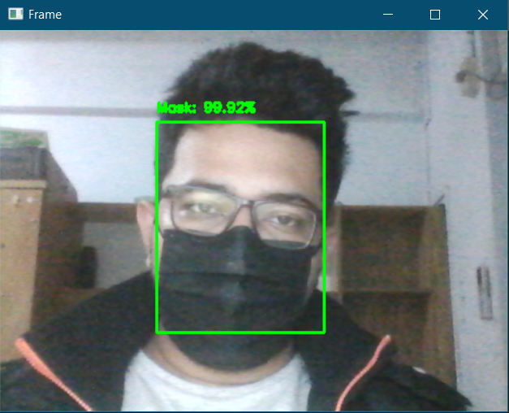
Detection(Image/Video)
No Mask
With mask

Slide 10
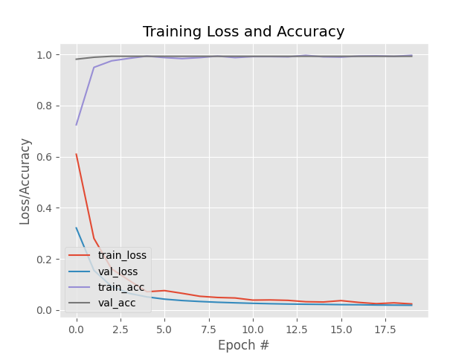
Accuracy

Slide 11
02
Limitations

Slide 12
What problem have I faced ？
Recognition
Less Data to train Upon

Slide 13
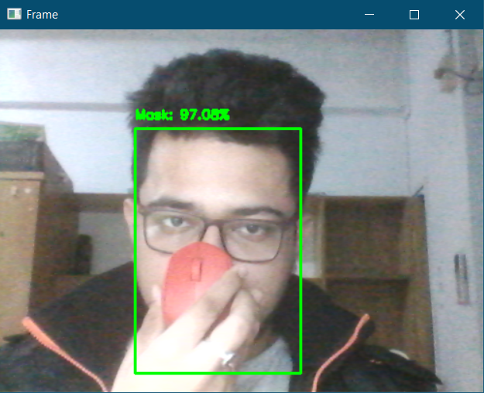
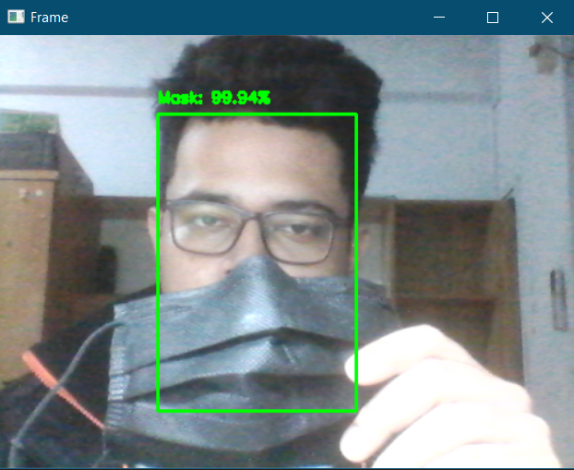
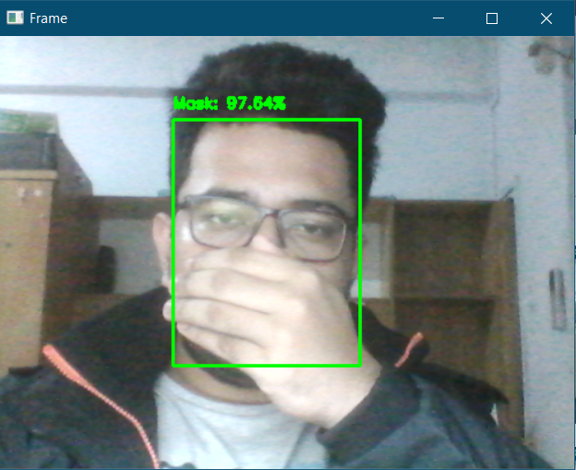
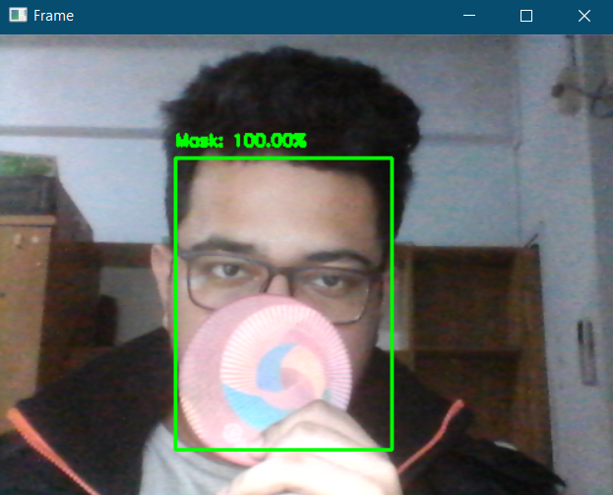
Recognition(Live Video)

Slide 14
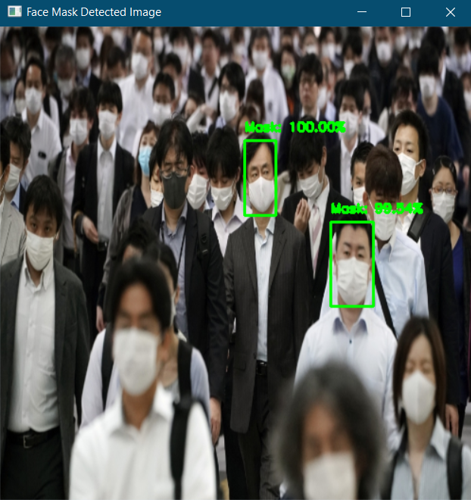
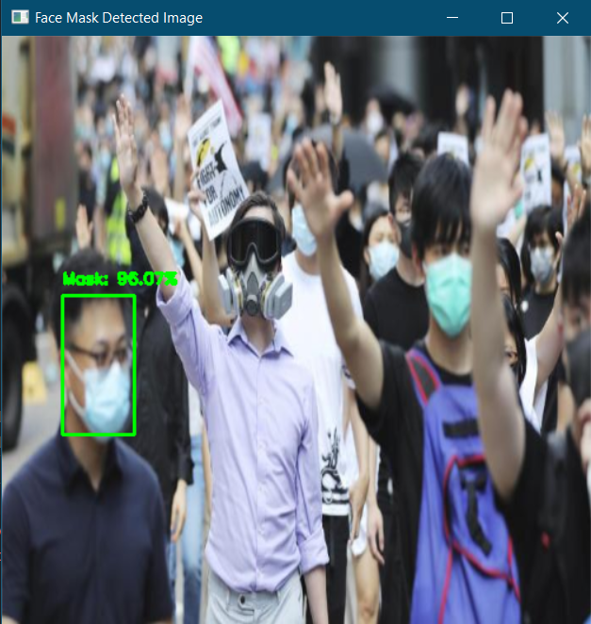
Recognition(Multiple faces Image)

Slide 15



Less Data
The problem mainly lies with the images in the dataset.
Most of the images in the dataset are synthetic images.
Notes:
The dataset is created using Facial Landmark Detection.

Slide 16
Thank You

